Slide 1
Simanta Kumar Roy
221-35-909
Topic : DRAM , SRAM , JK-Flip Flop

Slide 2
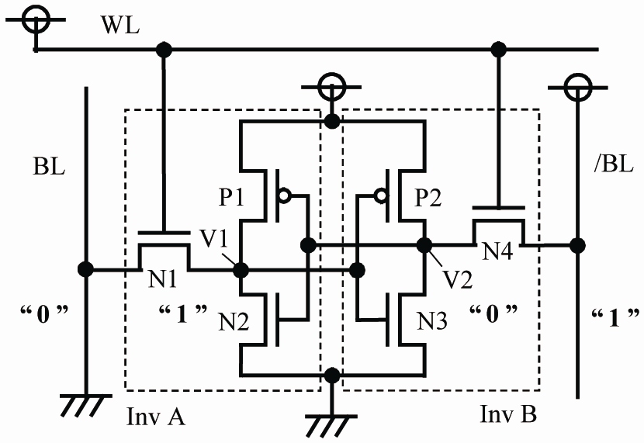
SRAM
The circuit requires 6 transistors.
4 to store the bit and 2 to control access to the cell.

Slide 3
SRAM
SRAM stands for Static Random-Access Memory.
It is a type of semiconductor memory used for temporary storage of data in electronic devices.
SRAM stores data in a static form, meaning it retains information as long as power is supplied to the memory.
Each bit of data in SRAM is stored using flip-flops, which are composed of transistors.
Unlike DRAM, SRAM does not require periodic refreshing.

Slide 4
DRAM
DRAM stands for Dynamic Random-Access Memory.
It is a type of semiconductor memory used for temporary storage of data in electronic devices.
DRAM stores data in a dynamic form, meaning it requires periodic refreshing to maintain data integrity.
DRAM is non-volatile memory, meaning it does not retain data when power is removed.
DRAM modules are commonly used in personal computers, servers, and other devices for primary memory storage.

Slide 5
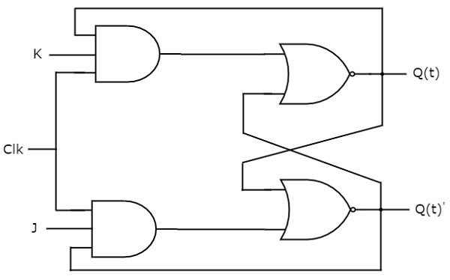
JK- FLIP FLOP
versatile sequential circuit for memory and state control.

Slide 6
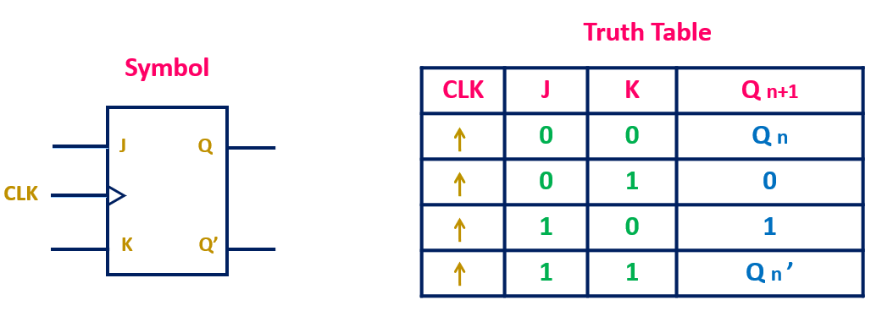
JK FLIP FLOP

Slide 7
THANK YOU
SIMANTA KUMAR ROY
221-35-909

